Slide 1



Bringing your whole self to work
Part of the DNA of Care Programme

Slide 2
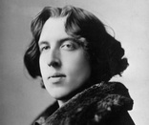
Authenticity
‘Be yourself, everyone else is already taken.’
Oscar Wilde

Slide 3

Authenticity and diversity
‘We are all of fundamental equal worth. At the same time, our community will be richest if we let all members contribute in their distinctive way, appreciating the differences in roles, education, backgrounds, interests, skills, characters, points of view, and so on.’
Laloux 2014
Photo © Pip Hardy

Slide 4
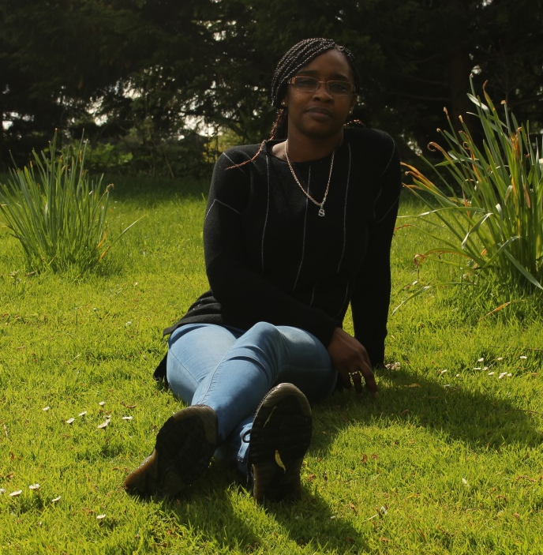
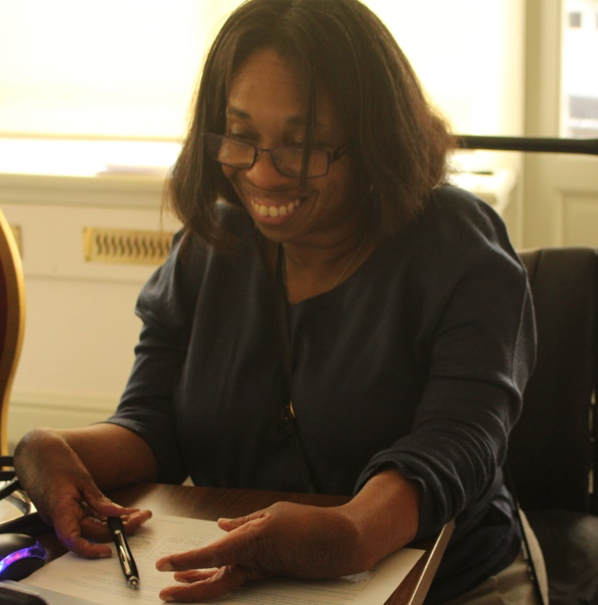
Authenticity and compassion
‘You don’t want to lose that authenticity, because that’s when you lose your compassion.’
  Sam Ming and Lydia Warren, 2018
Photo © Pip Hardy
Photo © Pip Hardy

Slide 5
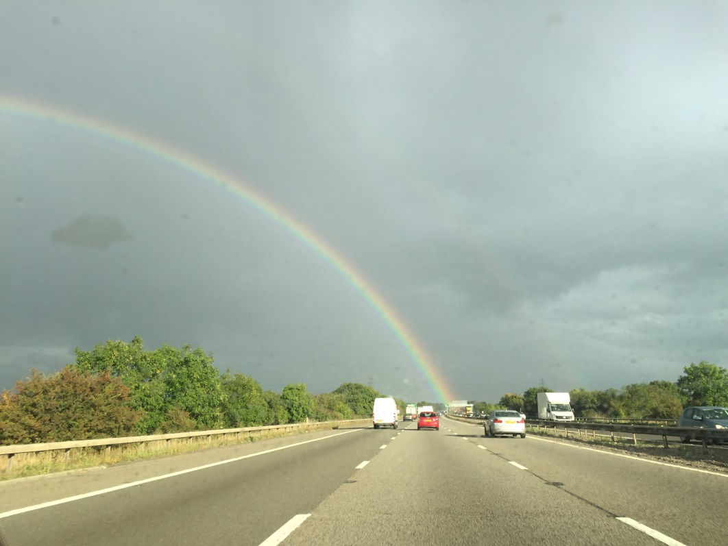
Showing up
‘The days of leaving your personal life at the company doorstep are over…we can’t expect to get 100 percent from people if only 50 percent is allowed to show up to work’.
www.greatplacetowork.co.uk
Photo © Pip Hardy

Slide 6
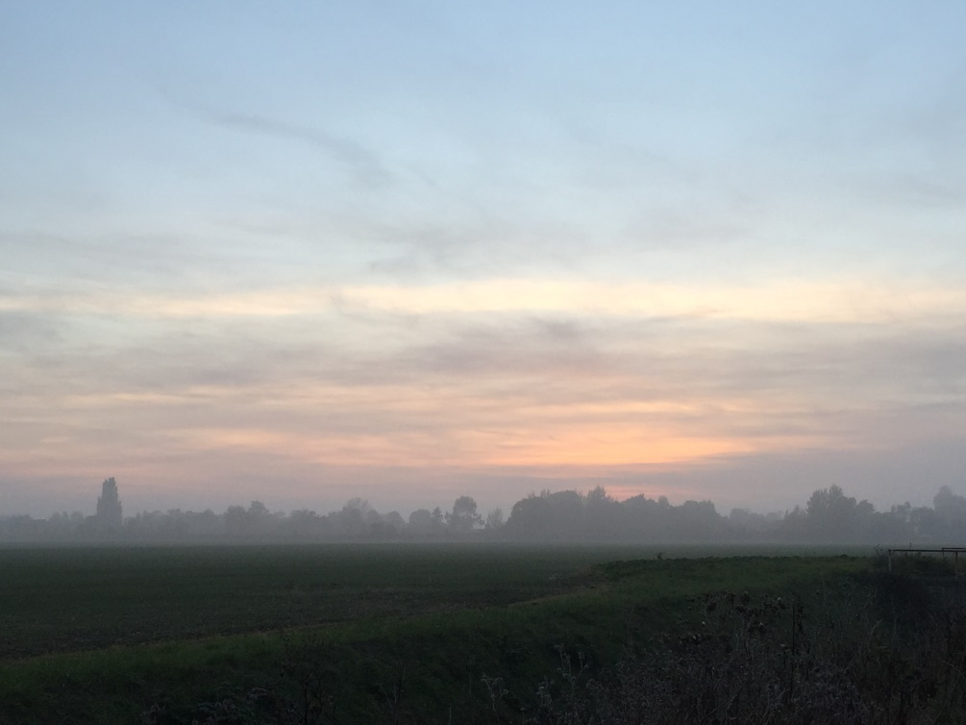
The impact of culture
‘Bringing your whole self to work isn't a corporate program.
It's a mindset that permeates the culture.
It happens because trust exists at every level of
the organization.’
Lissy and Henry 2015
Photo © Pip Hardy

Slide 7

Pieces or people?
‘Employees only bring a piece of themselves. People bring their whole selves.’
Sharlyn Lauby

Slide 8

The relationship between staff and patients
‘Focusing on this relationship could be one of the most important moves the healthcare system makes to drive better productivity, and improve experiences of care for millions of people – both staff and patients.’
Karen Deeny 2017

Slide 9
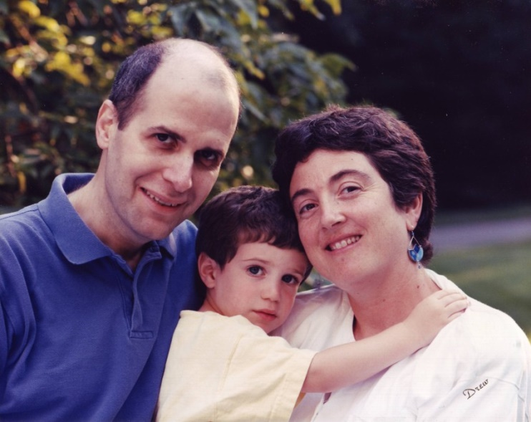
Re-writing the rules
‘I cannot emphasise enough how meaningful it was to me when care-givers revealed something about themselves that made a personal connection to my plight. The rule books, I’m sure, frown
on such intimate engagement between care-giver and patient. But maybe it’s time to rewrite them.’
Kenneth Schwartz

Slide 10

The DNA of Care
‘The intertwined relationship between patient care and staff well-being has been likened to the double helix. And so the stories we tell each other are like the DNA of care, transmitting information and shaping cultures, offering learning opportunities and, sometimes, healing.’
Pip Hardy and Tony Sumner, 2016

Slide 11
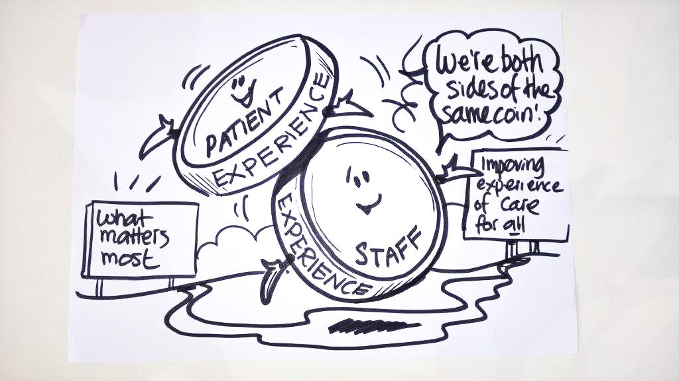
Two sides of the same coin
Staff experience drives patient experience.
‘Focusing on this relationship could be the most important move for the healthcare system to make.’
Karen Deeny, 2017

Slide 12
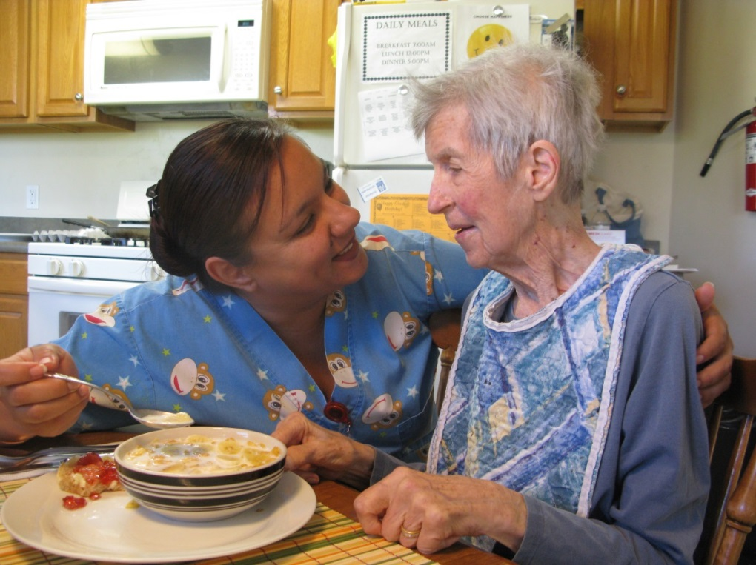
Compassion for everyone
‘Both staff and patients need care, compassion and respect.’
Michael West 2014
Photo © Pip Hardy

Slide 13
DNA of Care stories of bringing your whole self to work
A little bit awkward
Time to care…
Moonlight world
Forgotten to remember
I’m sorry
Stickers
Now I know health?
Touch
Toil
Why would you even say that?
No one should have to walk home in their pyjamas
An ordinary surgeon
The light on the water
Kirsty’s story

Slide 14
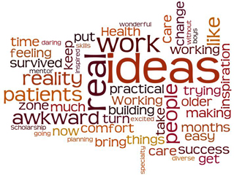
A little bit awkward
www.patientvoices.org.uk/flv/0995pv384s.htm Rebecca Lacey 2016

Slide 15
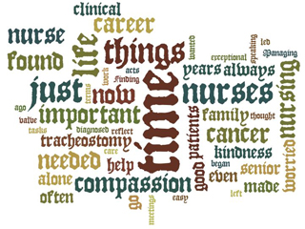
Time to care…
www.patientvoices.org.uk/flv/0998pv384s.htm Jacqueline Richardson 2016

Slide 16
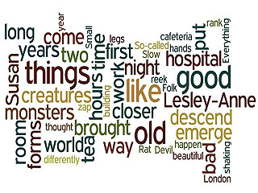
The moonlight world
www.patientvoices.org.uk/flv/1007pv384s.htm David Gilbert 2016

Slide 17
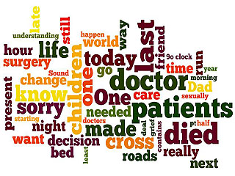
Forgotten to remember
www.patientvoices.org.uk/flv/1005pv384s.htm Ruth Bromley 2016

Slide 18
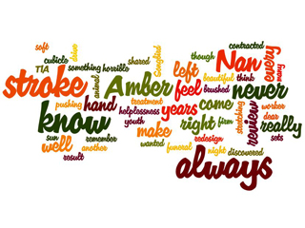
I’m sorry
www.patientvoices.org.uk/flv/0999pv384s.htm Sharon Knight 2016

Slide 19
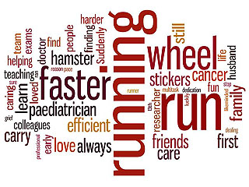
Stickers
www.patientvoices.org.uk/flv/1003pv384s.htm Claudia Gore 2016

Slide 20
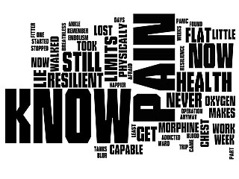
Now I know health?
www.patientvoices.org.uk/flv/1004pv384s.htm Nick Harland 2016

Slide 21
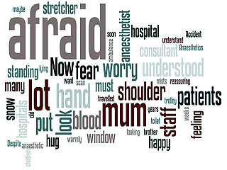
Touch
www.patientvoices.org.uk/flv/1006pv384s.htm Damon Kamming 2016

Slide 22

Toil
www.patientvoices.org.uk/flv/1020pv384s.htm Sheena Mansell 2016

Slide 23

Why would they even say that?
www.patientvoices.org.uk/flv/1021pv384s.htm Yvonne John 2016

Slide 24
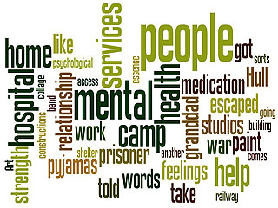
Nobody should have to walk home in their pyjamas
www.patientvoices.org.uk/flv/1022pv384s.htm Chris Wood 2016

Slide 25

An ordinary surgeon
www.patientvoices.org.uk/flv/1024pv384s.htm Graham Mackenzie 2016

Slide 26

The light on the water
www.patientvoices.org.uk/flv/1025pv384s.htm Karen Deeny 2016

Slide 27
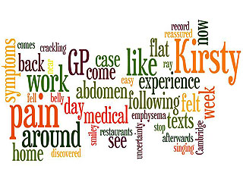
Kirsty’s tale
www.patientvoices.org.uk/flv/1027pv384s.htm Graham Mackenzie 2016

Slide 28
Questions for reflection
How do these stories illustrate showing up fully and authentically?
How do these stories highlight the challenges when staff feel unable to bring their whole selves to work?
How do these stories illustrate the ways in which people have demonstrated courage in allowing themselves to be truly seen as the people they are?

Slide 29
Questions for reflection
How might you use these stories to highlight the connection between bringing your whole self to work and staff engagement?
How do these stories reflect individuals taking responsibility for bringing more of themselves into the workplace?
How do these stories reflect ‘uncovering’ of people’s identities and experiences?
How do these stories illustrate the ‘re-writing of the rule books’ that Kenneth Schwartz called for?

Slide 30
Questions for reflection
In what ways can the DNA of Care staff digital stories help you, your team and your organisation make improvements in experiences of care through bringing your whole selves to work?
What three things does xx story focus your attention on, in terms of what you (or we) should do next?
Having seen xx story, what is the one thing you feel compelled to do immediately?

